Slide 1

Logistic Regression (Math)
Presented by:
Elizer Ponio Jr.
Department of Computer Science
College of Computing and Information Technologies

Slide 2
Outline
The Logit function
Finding the best fit line using Maximum Likelihood

Slide 3
Obese
Not Obese
1
2
3
4
5
In logistic regression, our goal is to draw the best fitting S-curved line to the data

Slide 4
In logistic regression, our goal is to draw the best fitting S-curved line to the data
Obese
Not Obese
1
2
3
4
5

Slide 5

To do this, we need to transform the y-axis from a probability of obesity scale…
Obese
Not Obese
1
2
3
4
5

Slide 6

3
2
To a log(odds of obesity) scale.
1
0
-1
-2
-3

Slide 7
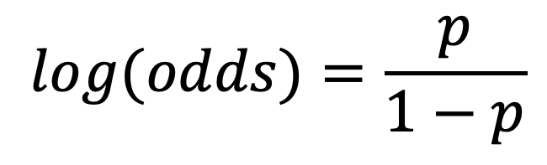
+ Infinity
1
3
2
1
0
-1
0
-2
-3
1
2
3
4
5
- Infinity
We do that using the logit function:
$$log(odds)=\frac{p}{1−p}$$

Slide 8

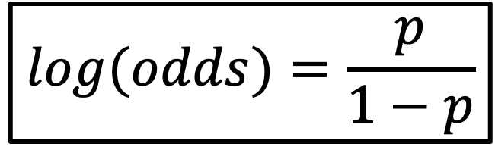
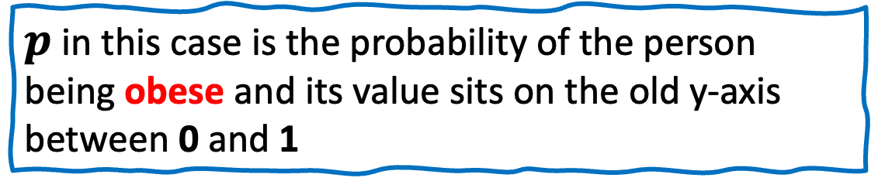
+ Infinity
1
3
2
1
0
-1
0
-2
-3
1
2
3
4
5
- Infinity
$$log(odds)=\frac{p}{1−p}$$
$p$ in this case is the probability of the person being obese and its value sits on the old y-axis between 0 and 1

Slide 9

3
2
We do that with the logit function
1
0
-1
-2
-3

Slide 10
+ Infinity
3
The only problem is that this transformation pushes the raw data to positive infinity and negative infinity
2
1
0
-1
-2
-3
- Infinity

Slide 11
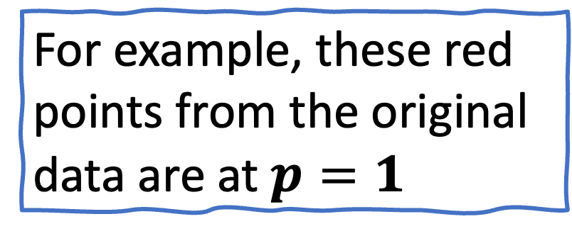
For example, these red points from the original data are at $p=1$
1
0
1
2
3
4
5

Slide 12

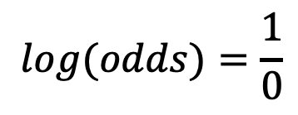
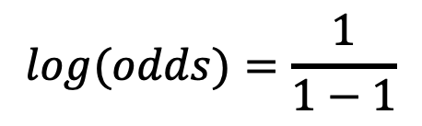
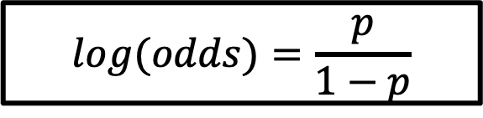


If we plug in $p=1$ and do the math..
1
$$log(odds)=\frac{p}{1−p}$$
$$log(odds)=\frac{1}{1−1}$$
$$log(odds)=\frac{1}{0}$$
0
$$log\left(odds\right)= \ln{(1)}−\ln{(0)}$$
1
2
3
4
5
$$log\left(odds\right)= +infinity$$

Slide 13

+ Infinity
If we plug in $p=1$ and do the math..
3
2
$$log(odds)=\frac{p}{1−p}$$
1
$$log(odds)=\frac{1}{1−1}$$
0
$$log(odds)=\frac{1}{0}$$
-1
$$log\left(odds\right)= \ln{(1)}−\ln{(0)}$$
-2
$$log\left(odds\right)= +infinity$$
-3

Slide 14

+ Infinity
This means that the original samples that were labeled obese are at positive infinity on the new y-axis
3
2
1
0
-1
-2
-3

Slide 15

+ Infinity
1
3
2
0.5
1
0
-1
0
-2
-3
1
2
3
4
5
- Infinity
As a result, the original y-axis from 0.5 to 1 is stretched out from 0 to positive infinity on the new y-axis

Slide 16


+ Infinity
1
3
2
0.5
1
0
-1
0
-2
-3
1
2
3
4
5
- Infinity
Similarly, 0.5 to 0 on the old y-axis is stretched out from 0 to negative infinity on the new y-axis.

Slide 17
+ Infinity
On the other hand, the original samples that were labeled not obese are at negative infinity on the new y-axis
3
2
1
0
-1
-2
-3
- Infinity

Slide 18

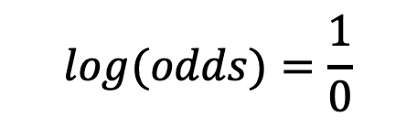
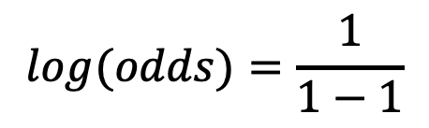
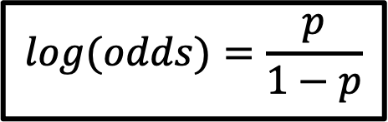

+ Infinity
For example, these red points from the original data are at $p=1$
3
2
$$log(odds)=\frac{p}{1−p}$$
1
$$log(odds)=\frac{1}{1−1}$$
0
-1
$$log(odds)=\frac{1}{0}$$
-2
$$log\left(odds\right)=\text{+∞}$$
-3
- Infinity

Slide 19
+ Infinity
3
Ultimately, we end up with log (odds of obesity) on the new y-axis…
2
1
0
-1
-2
-3
- Infinity

Slide 20
+ Infinity
3
2
1
log (odds of obesity)
0
-1
-2
-3
- Infinity

Slide 21
+ Infinity
3
Then we can draw a best fitting line on the graph
2
1
0
-1
-2
-3
- Infinity

Slide 22
+ Infinity
3
And this means that the residuals are also equal to positive and negative infinity
2
1
0
-1
-2
-3
- Infinity

Slide 23
+ Infinity
3
And this means that we cannot use least squares to get the best fitting line
2
1
0
-1
-2
-3
- Infinity

Slide 24
+ Infinity
3
Instead, we use maximum likelihood.
2
1
0
-1
-2
-3
- Infinity

Slide 25
Outline
The Logit function
Finding the best fit line using Maximum Likelihood

Slide 26
+ Infinity
3
First, we project the raw data points to the candidate line
2
1
0
-1
-2
-3
- Infinity

Slide 27
+ Infinity
3
To get the candidate log (odds) value for each data point
2
1
0
-1
-2
-3
- Infinity

Slide 28

+ Infinity
3
For example, the log (odds) of this data point is 2.1
2
1
0
-1
-2
-3
- Infinity

Slide 29
+ Infinity
3
And the log(odds) of this data point is -1.4
2
1
0
-1
-2
-3
- Infinity

Slide 30
+ Infinity
3
Then we transform the candidate log (odds) to candidate probabilities using this formula
2
1
0
-1
-2
-3
- Infinity

Slide 31
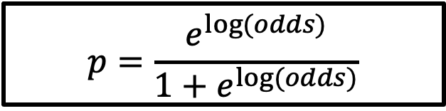
+ Infinity
1
3
2
1
0
-1
0
-2
-3
1
2
3
4
5
- Infinity
Then we transform the candidate log (odds) to candidate probabilities using this formula:
$$p=\frac{e^{\log{(odds)}}}{1+e^{\log{(odds)}}}$$

Slide 32
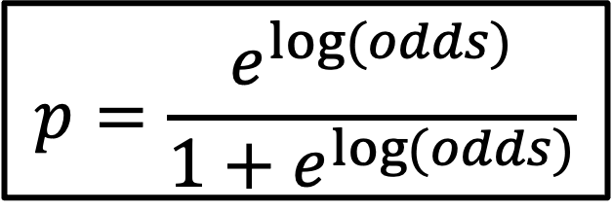
+ Infinity
3
Now, let us see how we use this equation:
in action!
2
1
$$p=\frac{e^{\log{(odds)}}}{1+e^{\log{(odds)}}}$$
0
-1
-2
-3
- Infinity

Slide 33
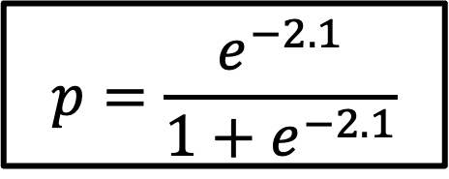
+ Infinity
3
For example, the log(odds) of this data point is -2.1
We substitute -2.1 for the log odds
And we get p = 0.1
2
1
0
$$p=\frac{e^{−2.1}}{1+e^{−2.1}}$$
-1
-2
-3
- Infinity

Slide 34
p = 0.1 gives us the y-coordinates on the S-curved line
1
0
1
2
3
4
5
Weight

Slide 35
And we do the same thing for all data points!
1
0
1
2
3
4
5
Weight

Slide 36
Now we use the observed status to calculate the their likelihood given the shape of the S-curve
Obese
Not Obese
1
2
3
4
5
Weight

Slide 37
We will start by calculating the likelihood of the obese persons given the shape of the S-curve line.
Obese
Not Obese
1
2
3
4
5
Weight

Slide 38
The likelihood that this person is obese given the shape of the S-curve line is the value on the y-axis where the point intersects the S-curve line.
Which is 0.49
Obese
Not Obese
1
2
3
4
5
Weight

Slide 39
The likelihood of this person is obese is 0.9
Obese
Not Obese
1
2
3
4
5
Weight

Slide 40
The likelihood that these people are obese is 0.91, 0.91 and 0.92
Obese
Not Obese
1
2
3
4
5
Weight

Slide 41
Likelihood of data give the S-curve = 0.49 * 0.9 * 0.91 * 0.91 * 0.92…
Obese
The likelihood for all obese persons is just the product of the individual likelihoods
Not Obese
1
2
3
4
5
Weight

Slide 42
Now, let us calculate the likelihoods for the persons who are not obese
Obese
Not Obese
1
2
3
4
5
Weight

Slide 43
For these persons, the likelihood is calculated as:
Likelihood = (1 – probability of the person is obese)
Obese
Not Obese
1
2
3
4
5
Weight

Slide 44
The probability that this person is obese is 0.9
So the probability and likelihood that this person is not obese is
(1 - 0.9)
Obese
Not Obese
1
2
3
4
5
Weight

Slide 45
The probability that this person is obese is 0.3
So the probability and likelihood that this person is not obese is
(1 - 0.3)
Obese
Not Obese
1
2
3
4
5
Weight

Slide 46
The probability that these persons is obese are both 0.1
So the probability and likelihood that these persons are not obese is (1 - 0.1)
Obese
Not Obese
1
2
3
4
5
Weight

Slide 47
Now we can include the individual likelihoods for the persons that are not obese to the equation for the overall likelihood
Obese
Likelihood of data give the S-curve = 0.49 * 0.9 * 0.91 * 0.91 * 0.92 * (1– 0.9) * (1 – 0.3) * (1 – 0.01) * (1 - 0.1)
Not Obese
1
2
3
4
5
Weight

Slide 48
Likelihood of data give the S-curve = 0.49 * 0.9 * 0.91 * 0.91 * 0.92 * (1– 0.9) * (1 – 0.3) * (1 – 0.01) * (1 - 0.1)
Obese
Although it is possible to calculate the likelihood as the product of the individual likelihoods, statisticians prefer to calculate the log of the likelihood
Not Obese
1
2
3
4
5
Weight

Slide 49
log(Likelihood of data give the S-curve) = log(0.49) + log(0.9) + log( 0.91) + log(0.91) + log(0.92) + log(1– 0.9) + log(1 – 0.3) + log(1 – 0.01) + log(1 - 0.01)
Obese
With the log of the likelihood, we add the logs of the individual likelihoods instead of multiplying the individual likelihoods
Not Obese
1
2
3
4
5
Weight

Slide 50
Thus, the log(Likelihood of data give the S-curve) = -3.77
Obese
Not Obese
1
2
3
4
5
Weight

Slide 51
Thus, the log(Likelihood of data give the S-curve) = -3.77
3
2
This also means that the log-likelihood of the original straight line is -3.77
1
0
-1
-2
-3

Slide 52
We can rotate this line and calculate the log likelihood again until we get a line that maximize the likelihood and that’s the chosen one to have the best fit.
3
2
1
0
-1
-2
-3

Slide 53
Appendices

Slide 54
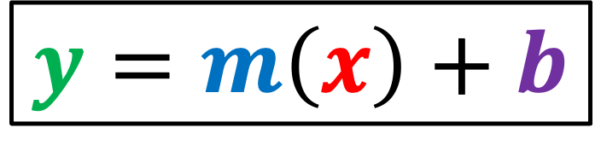
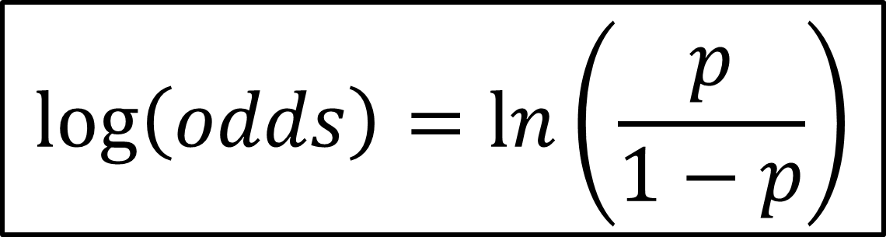
Logit Function and the Equation of the Line
$$\log\left(odds\right)=\ln\left(\frac{p}{1−p}\right)$$
$$y=m\left(x\right)+b$$

Slide 55
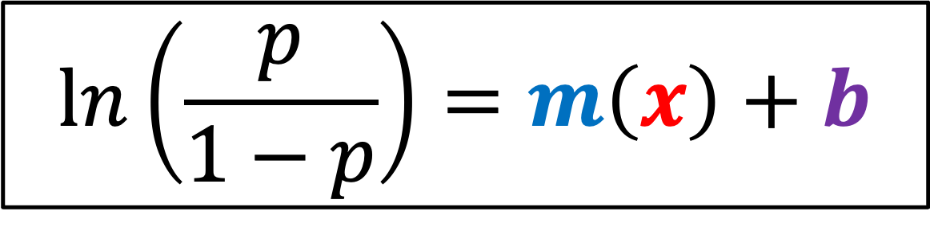
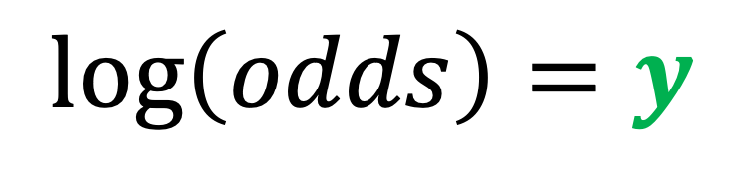
Logit Function and the Equation of the Line
$$\log\left(odds\right)=y$$
$$\ln\left(\frac{p}{1−p}\right)=m\left(x\right)+b$$

Slide 56
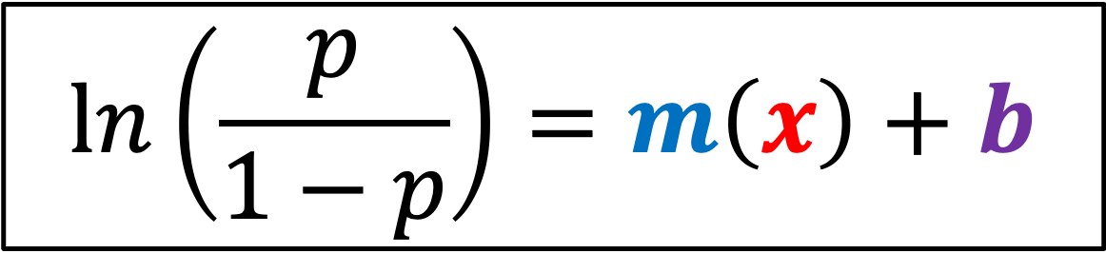
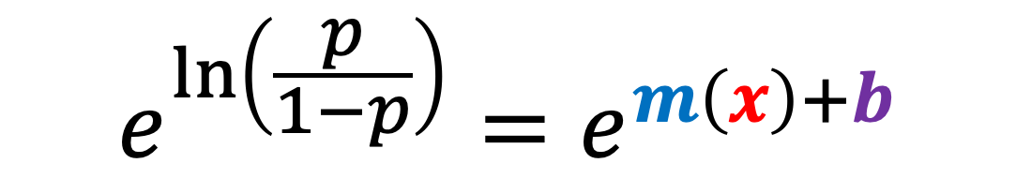
Logistic/Sigmoid Function
$$\ln\left(\frac{p}{1−p}\right)=m\left(x\right)+b$$
Exponentiate both sides, we get:
$$e^{\ln\left(\frac{p}{1−p}\right)}=e^{m\left(x\right)+b}$$

Slide 57
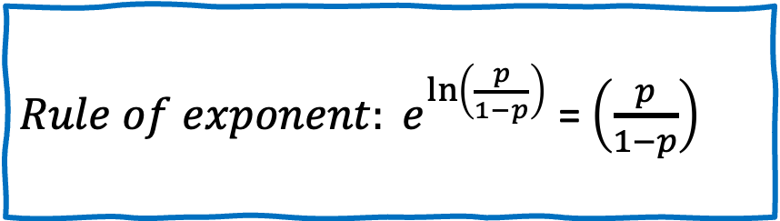
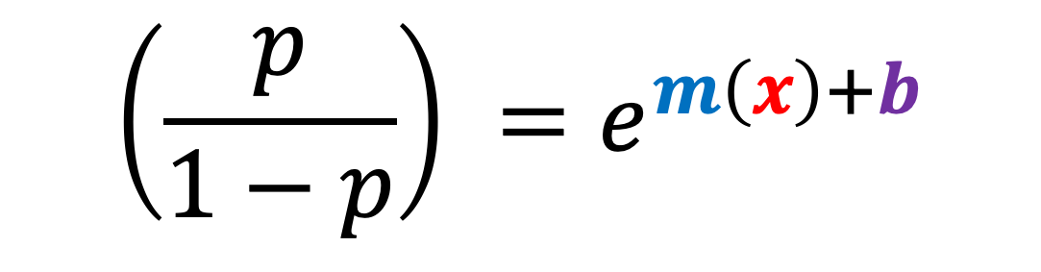

Logistic/Sigmoid Function
$$e^{\ln\left(\frac{p}{1−p}\right)}=e^{m\left(x\right)+b}$$
$Rule of exponent: e^{\ln\left(\frac{p}{1−p}\right)}$ = $\left(\frac{p}{1−p}\right)$
$$\left(\frac{p}{1−p}\right) =e^{m\left(x\right)+b}$$

Slide 58

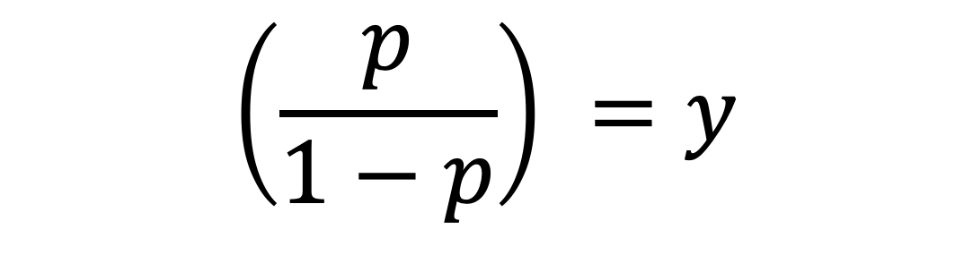

Logistic/Sigmoid Function
$$\left(\frac{p}{1−p}\right) =e^{m\left(x\right)+b}$$
$$Let y=e^{m\left(x\right)+b}$$
$$\left(\frac{p}{1−p}\right) =y$$

Slide 59
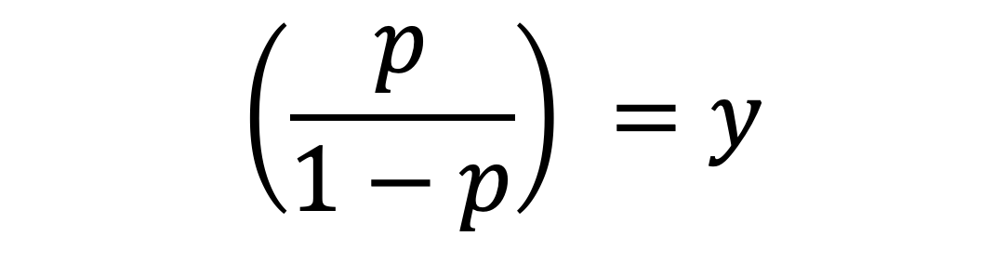

Logistic/Sigmoid Function
$$\left(\frac{p}{1−p}\right) =y$$
Multiply both sides with (1-p), we get:
$$p=y(1−p)$$

Slide 60



Logistic/Sigmoid Function
$$p=y(1−p)$$
Distribute $y$
$$p=y−y(p)$$

Slide 61



Logistic/Sigmoid Function
$$p=y−y(p)$$
Add $y(p)$ on both sides
$$p+y(p)=y$$

Slide 62



Logistic/Sigmoid Function
$$p+y(p)=y$$
Take out $p$
$$p(1+y)=y$$

Slide 63



Logistic/Sigmoid Function
$$p(1+y)=y$$
Divide both sides with $1+y$, we get:
$$p=\frac{y}{1+y}$$

Slide 64

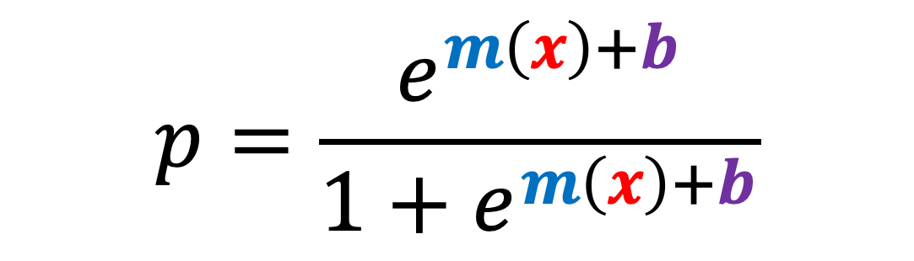

Logistic/Sigmoid Function
$$p=\frac{y}{1+y}$$
Change $y$ to $e^{m\left(x\right)+b}$
$$p=\frac{e^{m\left(x\right)+b}}{1+e^{m\left(x\right)+b}}$$

Slide 65
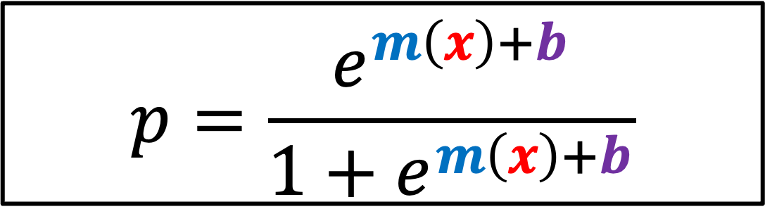
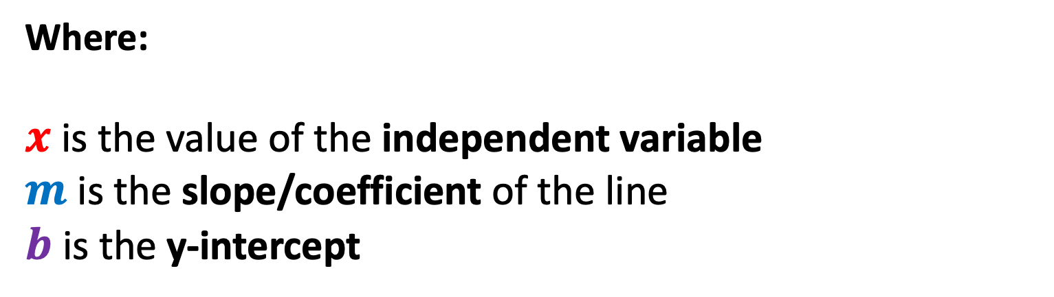
Probability of X
$$p=\frac{e^{m\left(x\right)+b}}{1+e^{m\left(x\right)+b}}$$
Where:
$x$ is the value of the independent variable
$m$ is the slope/coefficient of the line
$b$ is the y-intercept

Slide 66
Maximum Likelihood Estimation
Maximum likelihood estimation is a method that determines values for the parameters of a model.
The parameter values are found such that they maximize the likelihood that the process described by the model produced the data that were actually observed.
In Logistic Regression, MLE is used as the Cost Function.

Slide 67
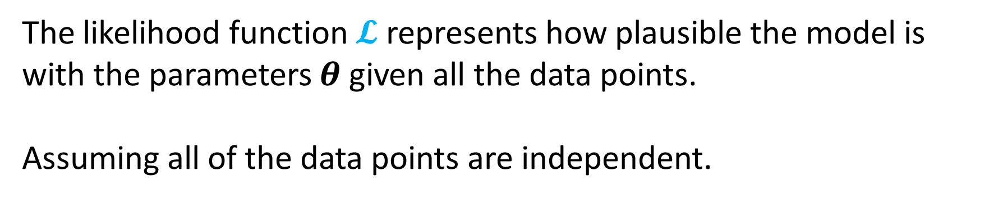
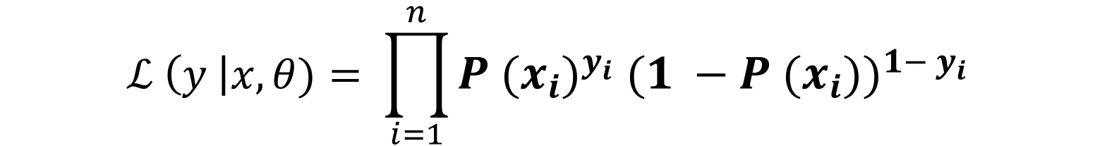
Maximum Likelihood
$ℒ \left(y \right|x, θ)= ℙ$ $\left(y_{1} \right|x_{1} β) ∗ℙ \left(y_{2} \right|x_{2} β)…∗ ℙ$ $\left(y_{n} \right|x_{n} β)$
$$ℒ \left(y \right|x,θ)= \prod_{i=1}^{n}{P {{(x}_{i})}^{y_{i}} {(1 −P (x_{i}))}^{1− y_{i}}}$$
The likelihood function $𝓛$ represents how plausible the model is with the parameters $θ$ given all the data points.
Assuming all of the data points are independent.

Slide 68
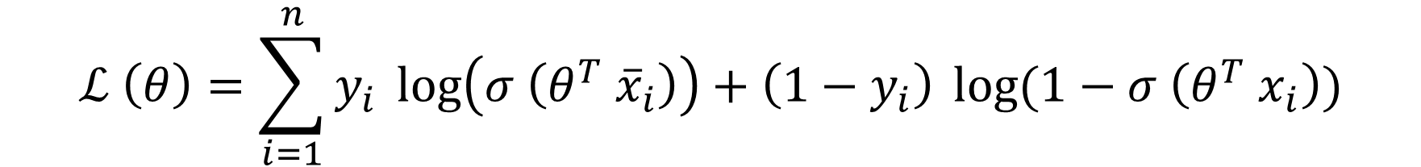

Log Likelihood
$$ℒ (θ)= \prod_{i=1}^{n}{P {{(x}_{i})}^{y_{i}} {(1 −P (x_{i}))}^{1− y_{i}}}$$
$$ℒ \left(θ\right)=\sum_{i=1}^{n}{y_{i}} \log\left(σ \left(θ^{T} {\overline{x}}_{i}\right)\right)+\left(1−y_{i}\right) \log{(1−σ \left(θ^{T} x_{i}\right))}$$

Slide 69
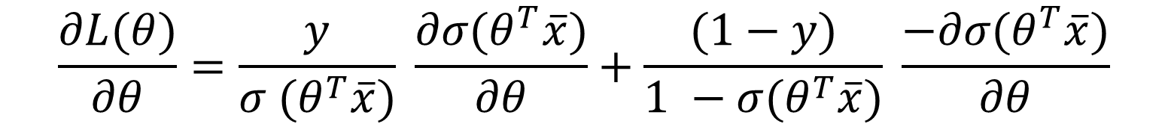
Gradient Ascent
$$\frac{∂L(θ)}{∂θ}=\frac{y}{σ (θ^{T}\overline{x})} \frac{∂σ(θ^{T}\overline{x})}{∂θ}+\frac{(1−y)}{1 −σ(θ^{T}\overline{x})} \frac{−∂σ(θ^{T}\overline{x})}{∂θ}$$
$$\frac{∂L(θ)}{∂θ}=\left(y−p \left(x\right)\right) \overline{x}$$
$$\frac{∂L(θ)}{∂θ}=\left(y−σ (θ^{T}\overline{x})\right) \overline{x}$$
Get the derivative of the log likelihood with respect to theta $θ$

Slide 70
Gradient Ascent
$$θ^{+} = θ^{−}+ α (\frac{∂L(θ)}{∂θ})$$
$$θ^{+} = θ^{−}+ α\left(y−p \left(x\right)\right) \overline{x}$$
Equation to update the logistic regression model parameters $θ$

Slide 71
References
https://www.youtube.com/watch?v=vN5cNN2-HWE&list=PLblh5JKOoLUKxzEP5HA2d-Li7IJkHfXSe&index=2&t=382s
https://www.youtube.com/watch?v=BfKanl1aSG0&list=PLblh5JKOoLUKxzEP5HA2d-Li7IJkHfXSe&index=3

